Slide 1
Milestone 1 – Team Formation
Notes:
Hi there, my name is DB and I have got the honor of introducing SIMTECH to you. *click*

Slide 2

SIMTECH – Who we are
Sharath Silveru
  Conceptual Model
Aleksei Baidarov
  Data Collection & Analysis
Pham Huu Quang
  Chief Software Architect
Sai Vivek
  Experimental Design
Zeynep Ece Ergin
  Validation & Quality Control
Daniel Bokelmann
  Team Lead
Milestone 1 – Team Formation
Notes:
And these are our responsibilities.

Slide 3
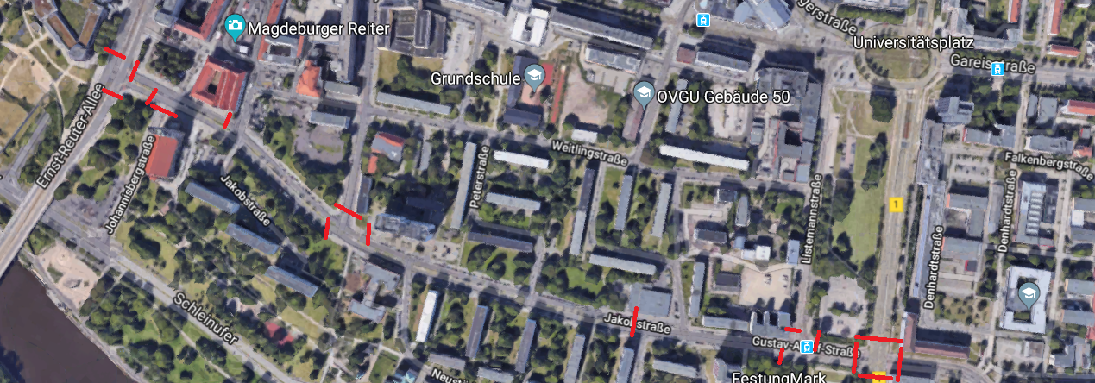
SIMTECH – Actual situation
Questions regarding a new tram-line:
  How many stops, how many tracks could it have?
  What effect would a new tram have on existing choke-points?
  …
Milestone 1 – Team Formation
Notes:
Here‘s Birds perspective, so that you can get a feeling for the task ahead
You can see how large this one is
And whwere some of the choke points are

Slide 4
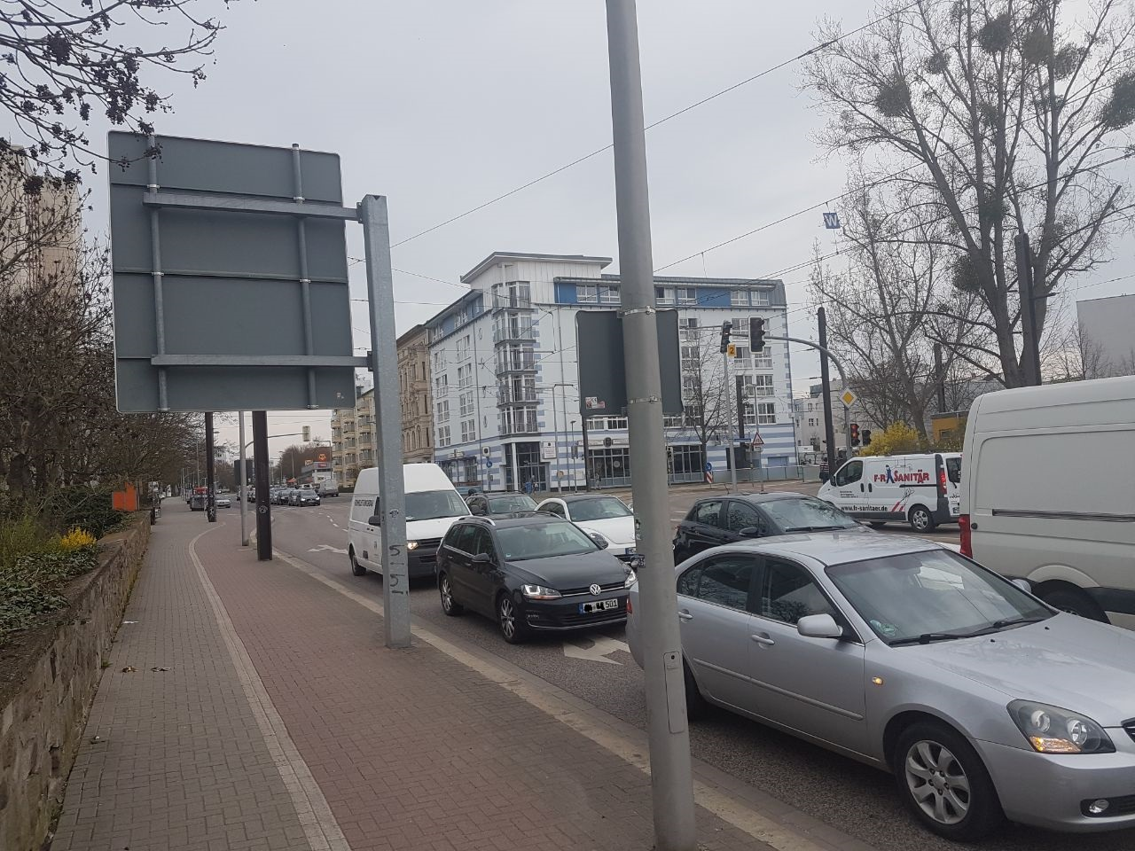
SIMTECH – What we want to do as a team
Create
  …value for the customer
  …value for our neighbours
Apply
  …expert knowledge
  …planning skills
Experience
    …teamwork in the wild
    …building from scratch
    …consulting in a nutshell
Milestone 1 – Team Formation
Notes:
Simply put: We want to create value for the customer – if we were real consultants, that would be the second highest priority.
First would be getting paid. But as we dont get paid, we still might learn something – getting better at working with strangers for instance, and creating our own frameworks to perform in. From scratch.
This is a sandbox, but an even better one than an internship (which you would do alone) And get grades.
This is what we want to achieve in theory. *click*

Slide 5
SIMTECH – What we the project to be
Effective
    …in supporting the customer‘s decision-making
Efficient
  …in the usage of resources
Elegant
  …in modeling infrastructure
  …in architecting software
Milestone 1 – Team Formation
Notes:
So, who is SIMTECH? After much deliberation, we came up with the following distribution of roles, :
*fingerpointing* Sharath, main Conceptual modeler; Aleksei Baidarov, Pham Huu
Aleksei Baidarov,

Slide 6
SIMTECH – Continous Improvement
Problem: Slack (Budget usage: 4.000€)
Solution: Protocols of meetings with…
    Clear deadlines, timeboxes
    Clear tasks
    Clear responsibilities
Problem: Structure of meetings
Solution: Agenda to be sent beforehand
Problem: Competing Duties of Team Members
  Solution: Rolling Wave Planning at the end of every meeting
Milestone 1 – Team Formation
Notes:
So, who is SIMTECH? After much deliberation, we came up with the following distribution of roles, :
*fingerpointing* Sharath, main Conceptual modeler; Aleksei Baidarov, Pham Huu
Aleksei Baidarov,

